Slide 1
Happy Vally Kennel
Sponsors: Jim and Sally
Team Members: Brandon, Christian, Parker
Notes:
Project name – pick a cool sounding name for your project
Sponsors – list your project sponsors here (the people with the money)
Putting your sponsors name boldly out there for all to see is a great way to get their engagement and attention (necessary for any successful project).

Slide 2
The elevator pitch
For [Jim and Sally]
who [Need a way for customers to book reservations effectively]
the [HVK website]
is a [Online reservation system]
that [Allows clients to make reservations online].
Unlike [PetSmart]
our project [Allows users to make reservations online without their data being sold].

Slide 3
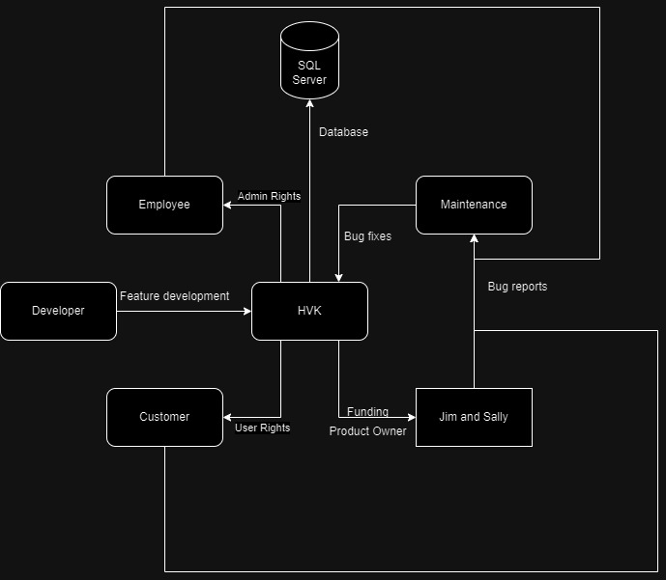
System context
Notes:
Include the context diagram here
See: https://en.wikipedia.org/wiki/System_context_diagram for details

Slide 4
The NOT list
IN | OUT
User CRUD | Online payment
Pet CRUD | Cats
Reservation CRUD
Basic search
Customer and Clerk side
Basic Authentication and Authorization
UNRESOLVED
Security
Should cats be able to be implemented later
Difference in look between customer and clerk pages
Notes:
List all the big ticket items you are (and are NOT) going to deliver within the scope of this project.
Before starting your project move all the UNRESOLVED ones to either IN or OUT.

Slide 5

Technical solution
SQL Server
IIS
HVK
User
Technologies:
C#, MVC, .NET, JavaScript
SQL Server
Moq, Azure DevOps, Git
IIS Express, Visual Studio 2022, SSMS
Notes:
This is about letting people know how we plan on building this thing.
If there are any tools or libraries assumptions you are making list them here.
Also if there are areas of the application architecture that are risky highlight those too.
This is to end up looking like a high level deployment diagram. Show the user the key pieces, DB server, web server, browser and let them know where code is running.
Doesn’t have to be a formal deployment, but convey the platforms.
Get browser requirements if a web application.

Slide 6

What keeps us up at night
Having a clerk and client side
Creating a reservation
Adding vaccinations
Proper validation
Notes:
This is your chance to call out any craziness you’ve heard while building the deck, and having a frank conversation with your sponsors and your team about how you are going to handle it.
This is perhaps on of the most powerful slides in the deck – it’s your chance to ask for whatever you need to be successful and the consequences if you don’t get it.
Use it!

Slide 7

How big is this thing?
Ship it!
Construction
Testing
Bug Fixes
~2months
1 wk
1 wk
This is a guess. Not a commitment.
Notes:
Give your sponsors some idea of how big this thing is (1, 3, or 6 monther).
Before you can complete this slide you and the team should create and estimate a high-level story list for the project.
This isn’t a commitment (too many unknowns). It’s just a really rough guess. Don’t treat it as anything else.

Slide 8
Trade-off sliders
 | The classic four
 | Feature completeness (scope)
 | Stay within budget (budget)
 | Deliver project on time (time)
 | High quality, low defects (quality)
OFF
ON
OFF
ON
OFF
ON
OFF
ON
 | Other important things
 | Ease of use
 | Effective code
OFF
ON
OFF
ON
OFF
ON
OFF
ON
Notes:
When push comes to shove, something has to give. Here we want to be clear on what that is.
On agile projects we flex on scope. But there could be others factors at play here so get ready to listen as you customer tells you which forces can bend (scope) and which are written in stone (usually budget).
Slider rules:
1. No two sliders can occupy the same level.
2. List other important project factors down below.

